Slide 1

Capstone Project -3
Coronavirus Tweet Sentiment Analysis
Presented By-Anjali Tidke
Shubham Dukare

Slide 2
Index
Title
Problem Statement
Understanding the Data
EDA on Features
Feature Engineering
Feature Selection
Models Training
Performance Metrics and Accuracy
Conclusion

Slide 3
Problem Statement
Problem Statement: The problem statement is to build a classification model to predict the sentiment of COVID-19 tweets.
Introduction: COVID-19 originally known as Coronavirus Disease of 2019, has been declared as a pandemic by the World Health Organization (WHO) on 11th March 2020.
Sentiment Analysis is the process of computationally identifying and categorizing opinions expressed in a piece of text, especially in order to determine whether the writer's attitude towards a particular topic is positive, negative, or neutral.

Slide 4
PROJECT FLOW
Importing Libraries
Loading the Dataset
EDA on features
Feature Engineering
Model Training
Performance metrics and training
Conclusion

Slide 5
The dataset contains features
UserName: This is the username(encoded in number) unique for every data points
ScreenName: This is the ScreenName(encoded in number) unique for every data points
Location: places where from tweets are coming
TweetAt: date of tweets data collected
OriginalTweet: Original tweets are stored (This feature is more important in our analysis)
Sentiment: types of sentiment (Positive, Negative, Neutral, Extremely Positive, Extremely Negative) it is a dependent variable.

Slide 6
Exploratory Data Analysis

Slide 7
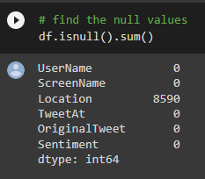
Checking Null values
From above observation, We can see that UserName and ScreenName column contains integer data type values and it's just a number. These columns will not be useful for modeling.
We can see location column and Sentiment column in details.
We need to remove special characters and stopwords for modeling.

Slide 8
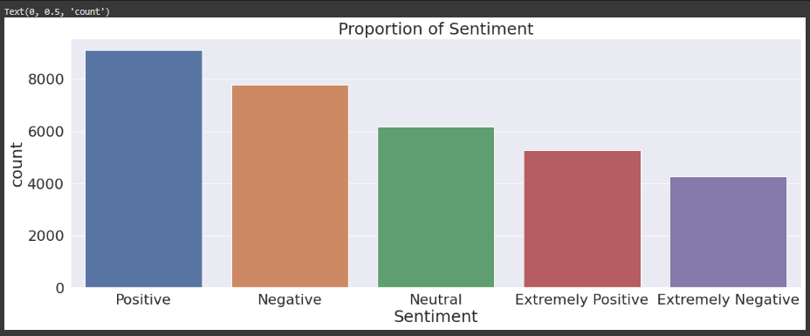
Graphical Representation of Sentiment Column
From above analysis we can see the higher number of sentiment column is positive column.

Slide 9
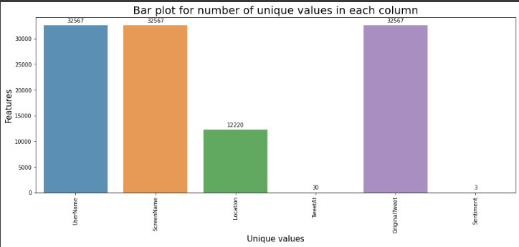
Unique values in each column:
From above analysis we can see unique value of each column

Slide 10
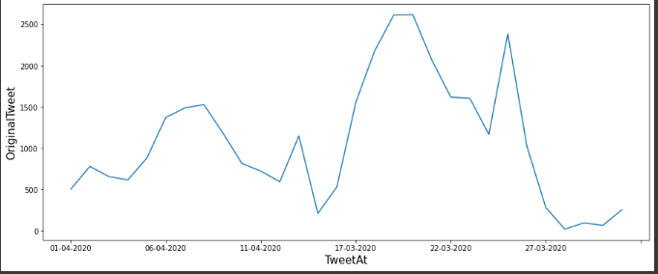
Countplot for original tweet according to TweetAt column:
From above analysis we can see most of Tweets are in between 17-03-2020 to 22-03-2020

Slide 11
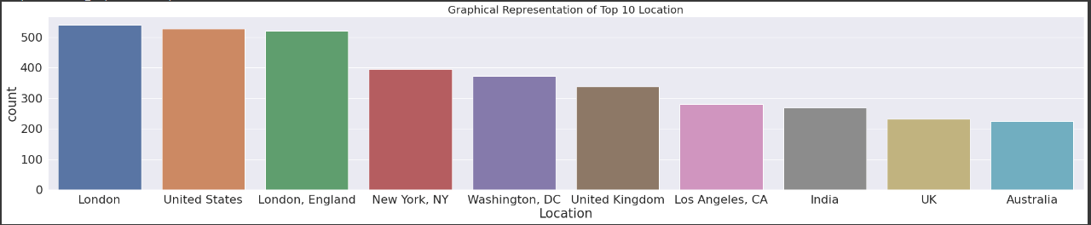
Top 10 Locations
From above graph, we can see that most of the tweets from London followed by united states

Slide 12
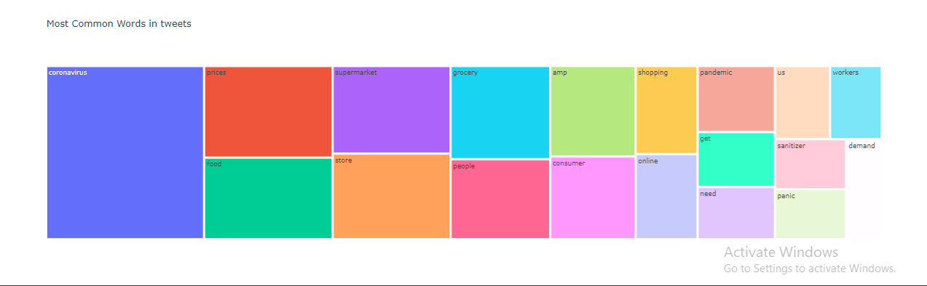
Most Common words
From above analysis you can see most common used words are coronavirus, prices, food supermarket and store.

Slide 13
EDA Work result:
Dataset have total 41157 rows and 6 columns.
We dropped the null values from location column.
"UserName" and "ScreenName" have only integer values. Which does not provide any meaningful information.
For modeling, we required only two columns "OriginalTweet" and "Sentiment".
We removed special characters from original tweets column.
After dropping and adding a new column, now we have 7 columns and 32567 rows.
There are five types of sentiments - Extremely Positive, Positive, Extremely Negative, Negative and Neutral.
We replaced Extremely positive to positive and Extremely negative to negative column.
The graphical representation of top 10 locations shows us that most of the tweets came from London followed by United States.

Slide 14
Total we used four models here
Logistic Regression Model
Decision Tree Classifier
Random Forest Classifier
Gradient Boosting Classifier.

Slide 15
Logistic Regression
Logistic regression is one of the most popular Machine Learning algorithms, which comes under the Supervised Learning technique.
It is used for predicting the categorical dependent variable using a given set of independent variables. Logistic regression is used for solving classification problems
Result of logistic Regression model:
Accuracy : 0.7710636207320068
Precision : 0.7857896154337569
Recall : 0.7710636207320068

Slide 16
Decision Tree Classifier
A decision tree is a non-parametric supervised learning algorithm, which is utilized for both classification and regression tasks. It has a hierarchical, tree structure, which consists of a root node, branches, internal nodes and leaf nodes.
Result of Decision Tree model:
Accuracy : 0.6101694915254238
Precision : 0.6082988270481552
Recall : 0.6101694915254238

Slide 17
Random Forest Classifier
Random Forest is a popular machine learning algorithm that belongs to the supervised learning technique. It can be used for both Classification and Regression problems in ML. It is based on the concept of ensemble learning, which is a process of combining multiple classifiers to solve a complex problem and to improve the performance of the model.
"Random Forest is a classifier that contains a number of decision trees on various subsets of the given dataset and takes the average to improve the predictive accuracy of that dataset."
Result of Random forest classifier model:
Accuracy : 0.7197248833210513
Precision : 0.7235239741354087
Recall : 0.7197248833210513

Slide 18
Gradient Boosting Classifier
Gradient boosting classifiers are a group of machine learning algorithms that combine many weak learning models together to create a strong predictive model. Decision trees are usually used when doing gradient boosting
Result of Gradient Boosting classifier model:
Accuracy : 0.6546303119626627
Precision : 0.6942037999145646
Recall : 0.6546303119626627

Slide 19
Conclusion:
Total Regression we have used four models here –
Logistic Regression Model
Decision Tree Classifier
Random Forest Classifier
Gradient Boosting Classifier.
Using Decision Tree Classifier, Random Forest Classifier and Gradient Boosting Classifier, We can see these models have less accuracy as compared to Logistic regression model. Out of four models, the best model for this dataset We can see the better accuracy is with Logistic Regression that is 77%.

Slide 20
Thank You!

